Slide 1
Enterprise AI
Assistant Platform
H100 GPU Resource Proposal
AI Center of Excellence · May 2026
RAG
Fine-Tuning
Governance
Agentic

Slide 2




BUSINESS PROBLEM
Engineering teams lose ~2 hrs/day to fragmented knowledge.
Knowledge Silos
Slow Incident Resolution
Confluence, Jira, Git, SharePoint — no unified search
Distributed knowledge delays MTTR significantly
High Onboarding Cost
Inconsistent Procedures
New engineers take weeks to navigate systems
Ops teams use outdated or conflicting runbooks
Target: 100–150 engineering users · Est. 500–900 hrs/month recoverable

Slide 3

ROI OPPORTUNITY
25–35%
500–900
↓ MTTR
reduction in search & troubleshooting effort
engineering hours saved per month
faster incident resolution
Strategic Value
Reduced dependency on external AI providers (cost + control)
Reusable platform across multiple Fiserv business units
Long-term institutional knowledge retention
Foundation for internal AI automation initiatives

Slide 4





PROPOSED SOLUTION
Secure internal AI assistant built on open-weight LLMs + enterprise RAG.
Enterprise RAG
Domain Fine-Tuning
Agentic Workflows
Hybrid BM25 + vector retrieval over Confluence, Jira, Git, SharePoint, ServiceNow
LoRA/QLoRA on 7B–32B OSS models (Llama, Qwen, Mistral, DeepSeek)
Tool-integrated agents for incident triage, runbook execution, ticket routing
Governance & Security
Evaluation Suite
Enterprise Infra
RBAC, PII/PCI filtering, audit logging, internal-only endpoints
>85% retrieval precision target, hallucination benchmarks, latency SLAs
vLLM + Kubernetes + OpenTelemetry — runs entirely on internal infrastructure

Slide 5

KNOWLEDGE SEPARATION STRATEGY
Fine-tune behavior. Retrieve knowledge. Never conflate the two.
Fine-Tuned into Model Weights
Managed Through RAG / Retrieval
Enterprise terminology
Confluence documentation
Workflow reasoning
Operational runbooks
Coding conventions
API documentation
VS
Escalation logic
Incident records
Structured response patterns
Policies & procedures
Tool usage patterns
Release notes
Agent orchestration behavior
Jira tickets & configs

Slide 6
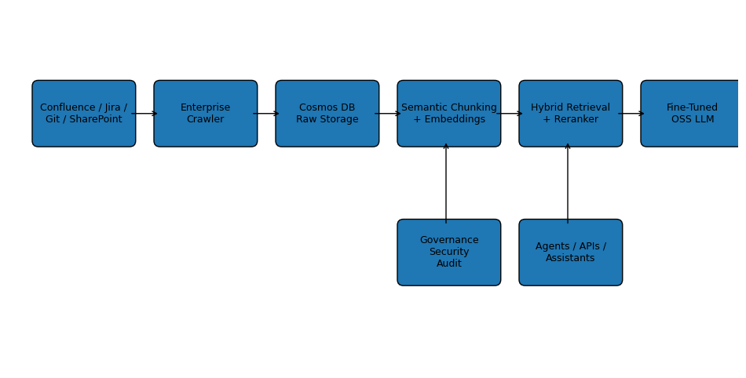
TARGET ARCHITECTURE
Cosmos DB · Azure AI Search · vLLM · PyTorch / LoRA · Kubernetes · OpenTelemetry

Slide 7
H100 GPU REQUEST
Phased allocation tied to measurable outcomes.
Phase 1
Months 1–3
Phase 2
Months 4–6
1–2 H100s
4–8 H100s
RAG baseline deployment
Domain-adapted model (14B–32B)
Hybrid retrieval pipeline
Multi-agent workflow integration
Initial fine-tuning (7B model)
Expanded user rollout
Internal pilot: 20–30 users
Production evaluation suite
H100 required for: LoRA fine-tuning · Large-batch embedding generation · Multi-agent inference · Evaluation pipelines

Slide 8
GOVERNANCE & SECURITY
No regulated data leaves the internal perimeter.
Identity & Access
Data Protection
RBAC integration
PII/PCI filtering at ingestion
Identity-aware retrieval
Internal-only inference
Access-controlled endpoints
Data lineage preservation
Auditability
Reliability Controls
Full audit logging
Human approval for critical actions
Prompt & response monitoring
Citation-based responses
Model version governance
Hallucination rate benchmarking

Slide 9
PILOT TIMELINE & SUCCESS CRITERIA
Phase 1
0–30 Days
Phase 2
30–60 Days
Phase 3
60–90 Days
Deliverables
Deliverables
Deliverables
RAG baseline + Confluence integration
Fine-tuned domain model (7B)
Agentic workflow integration
Hybrid retrieval pipeline
Reranking pipeline live
Governance dashboard live
Initial pilot: 20–30 users
Expanded knowledge coverage
Production eval suite
Success Targets
Success Targets
Success Targets
>85% retrieval precision
25–35% search effort reduction
Reduced MTTR for target workflows
<10% hallucination rate
Improved troubleshooting consistency
Reduced repetitive escalations
<15s response latency
Workflow completion accuracy
Production-readiness sign-off

Slide 10

The Ask
Approve Phase 1 Pilot
Initial H100 GPU Allocation (1–2 units)
30-day measurable pilot with defined success targets
Phased GPU allocation — scale only on proven outcomes
Full governance, security, and auditability from day one
Praveen Yellamaraju · Senior Application Analyst · Fiserv AI CoE Proposal 2026

